Slide 1
Applied Machine Learning Chapter 1
Faculty: Dr. simi v.r.

Slide 2
Computer Science
Symbol Based
Artificial Intelligence (AI)
Data Based
Machine Learning
Pattern Recognition
Symbolic Learning
Statistical Learning
Deep Learning
Robotics
Computer Vision (CV)
Speech Recognition
Natural Language Processing (NLP)
CNN
RNN
Computer Vision (CV)
Object Recognition

Slide 3
Machine Learning
What is Learning
Learning denotes changes in a system that enable the system to do the same task more efficiently next time.
Learning is an important feature of “Intelligence”.
Definition
A computer program is said to learn from experience E with respect to some class of tasks T and performance measure P, if its performance at tasks in T, as measured by P, improves with experience E. (Mitchell 1997) This means :
Given : A task T, A performance measure P, Some experience E with the task
Goal : Generalize the experience in a way that allows to improve your performance on the task.
Machine learning is programming computers to optimize a performance criterion using example data or past experience.

Slide 4
Common Classes of Problems in Machine Learning (ML)
There are common classes of problem in Machine Learning. The problem classes below are archetypes for most of the problems we refer to when we are doing Machine Learning.
Classification: Data is labelled meaning it is assigned a class, for example spam/non-spam or fraud/non-fraud. The decision being modelled is to assign labels to new unlabelled pieces of data. This can be thought of as a discrimination problem, modelling the differences or similarities between groups.
Regression: Data is labelled with a real value (think floating point) rather then a label. Examples that are easy to understand are time series data like the price of a stock over time, The decision being modelled is what value to predict for new unpredicted data.
Clustering: Data is not labelled, but can be divided into groups based on similarity and other measures of natural structure in the data. An example from the above list would be organising pictures by faces without names, where the human user has to assign names to groups, like iPhoto on the Mac.
Rule Extraction: Data is used as the basis for the extraction of propositional rules (antecedent/consequent like if-then). Such rules may, but are typically not directed, meaning that the methods discover statistically supportable relationships between attributes in the data, not necessarily involving something that is being predicted.

Slide 5
Machine Learning (Real world Problems)
Machine Learning Problems (Real world Problems)
Spam Detection: Given email in an inbox, identify those email messages that are spam and those that are not. Having a model of this problem would allow a program to leave non-spam emails in the inbox and move spam emails to a spam folder.
Credit Card Fraud Detection: Given credit card transactions for a customer in a month, identify those transactions that were made by the customer and those that were not. A program with a model of this decision could refund those transactions that were fraudulent.
Digit Recognition: Given a zip codes hand written on envelops, identify the digit for each hand written character. A model of this problem would allow a computer program to read and understand handwritten zip codes and sort envelops by geographic region.
Speech Understanding: Given an utterance from a user, identify the specific request made by the user. A model of this problem would allow a program to understand and make an attempt to fulfil that request. The iPhone with Siri has this capability.
Face Detection: Given a digital photo album of many hundreds of digital photographs, identify those photos that include a given person. A model of this decision process would allow a program to organize photos by person. Some cameras and software like iPhoto has this capability.

Slide 6
Machine Learning Problems
Product Recommendation: Given a purchase history for a customer and a large inventory of products, identify those products in which that customer will be interested and likely to purchase. A model of this decision process would allow a program to make recommendations to a customer and motivate product purchases. Amazon has this capability. Also think of Facebook, Google Plus and LinkedIn that recommend users to connect with you after you sign-up.
Medical Diagnosis: Given the symptoms exhibited in a patient and a database of anonymized patient records, predict whether the patient is likely to have an illness. A model of this decision problem could be used by a program to provide decision support to medical professionals.
Stock Trading: Given the current and past price movements for a stock, determine whether the stock should be bought, held or sold. A model of this decision problem could provide decision support to financial analysts.
Customer Segmentation: Given the pattern of behaviour by a user during a trial period and the past behaviours of all users, identify those users that will convert to the paid version of the product and those that will not. A model of this decision problem would allow a program to trigger customer interventions to persuade the customer to covert early or better engage in the trial.
Shape Detection: Given a user hand drawing a shape on a touch screen and a database of known shapes, determine which shape the user was trying to draw. A model of this decision would allow a program to show the platonic version of that shape the user drew to make crisp diagrams.

Slide 7
Handwritten Digit Recognition (A real world Problem)
Handwriting recognition (HWR), also known as Handwritten Text Recognition (HTR), is the ability of a computer to receive and interpret intelligible handwritten input from sources such as paper documents, photographs, touch-screens and other devices.
How to approach a real world problem that can be solved by ML algorithm
(Steps involved in the problem solving)
1. Preparation of dataset
-Ask different persons for writing digits from 0 to 9 in a paper.
- From each person 100 data can be collected.
- If 100 people is involving 10000 data can be prepared.
2. Scanning and digitizing of data

Slide 8
3. Pre-processing of data
- Improving the quality of images
- That may include denoising, contrast improvement and sharpening
4. Decide the percentage of data (80%-20% Or 70%-30%)using for testing
and training
6. Label the training data (Provide target values for each input data)
5. Training phase - Decide the Machine Learning algorithm suited for the particular application
-Train Convolution NN (CNN) with input images and Target values
- 80% of total data will be used for training
6. Testing phase
- 20% of data can be used for testing.
7. Assess the accuracy of the ML model.

Slide 9
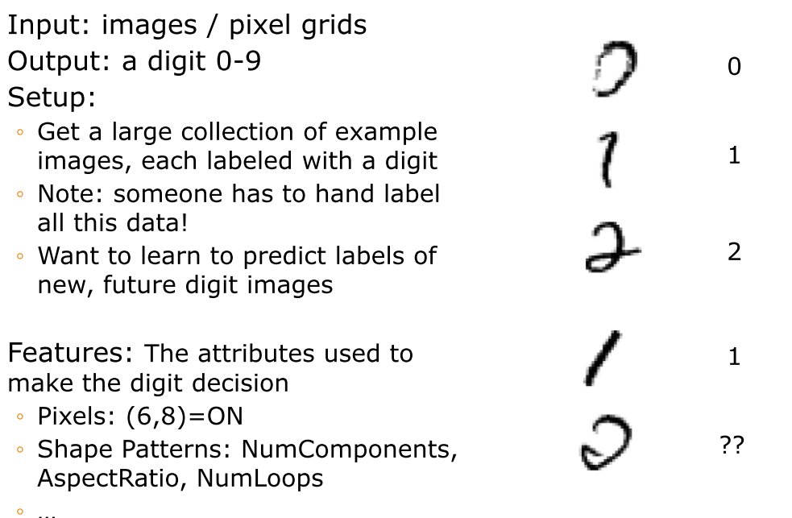
Example: Digit Recognition

Slide 10
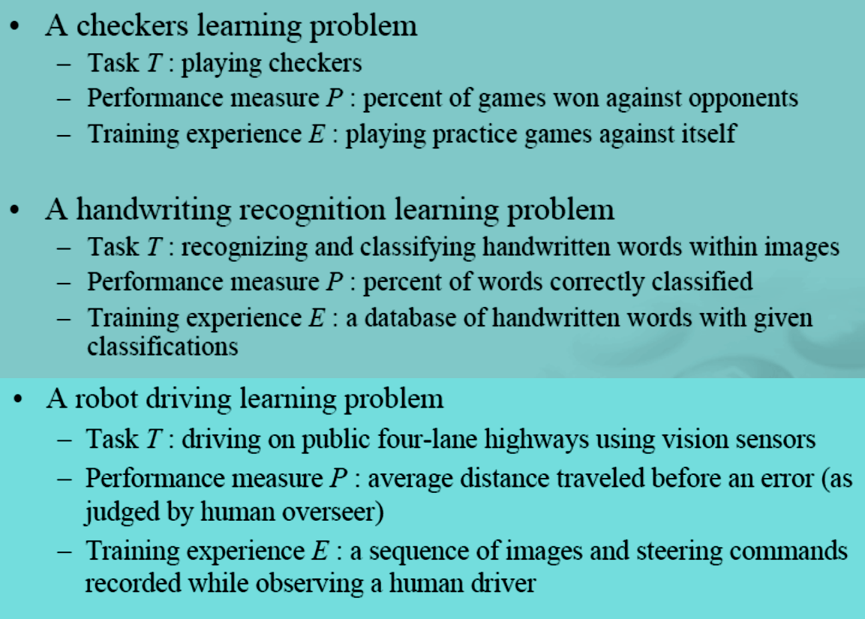
Well-Posed Learning Problems : Examples

Slide 11
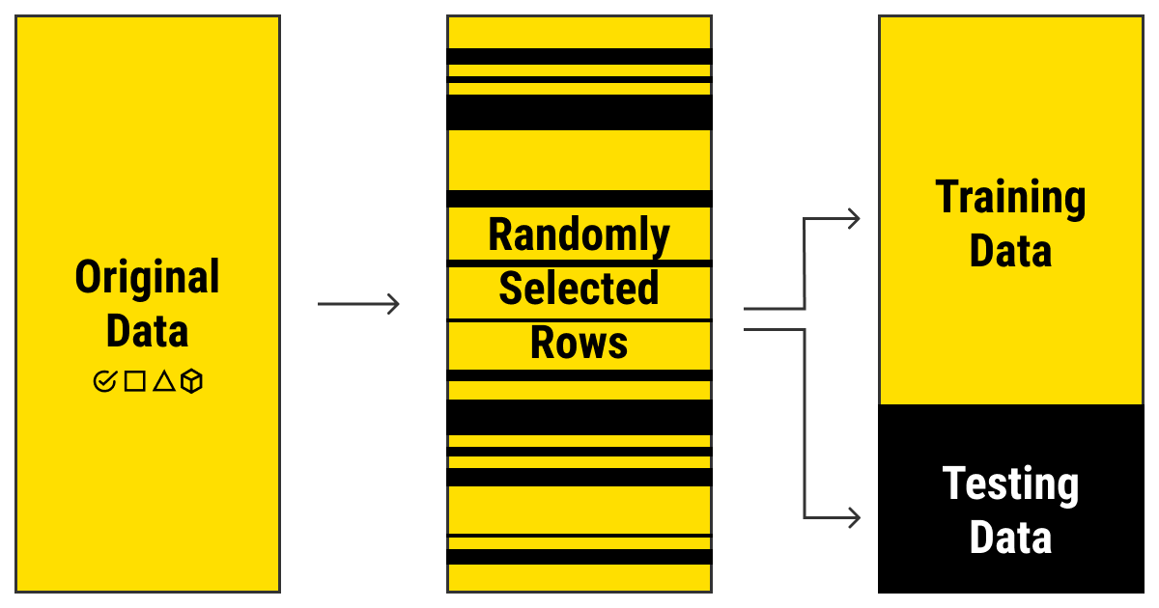
What Is Training Data in Machine Learning?
Training data is a set of samples (such as a collection of photos or videos, a set of texts or audio files, etc.) with assigned relevant and comprehensive labels (classes or tags) used to fit the parameters (weights) of a machine learning model with the goal of training it by example.
80%-20%
70%-30%

Slide 12
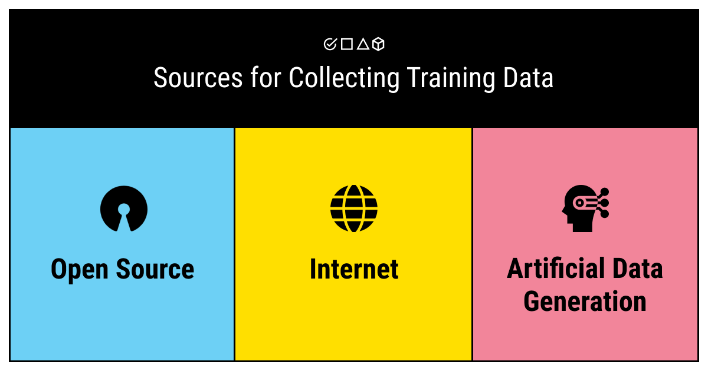
Where to get training data?
Open-source training data sets: The great benefit of this option is that it's free and it's already collected.
Web and IoT: This means that you use the Internet to collect the pieces of data. Alternatively, sensors, cameras, and other smart devices may provide you with the raw data that you will later need to annotate by hand.
Artificial training data sets: You have to create an ML model that will generate your data. This is a great way if you need large volumes of unique data to train your algorithm.

Slide 13
Illustrating Classification Task

Slide 14
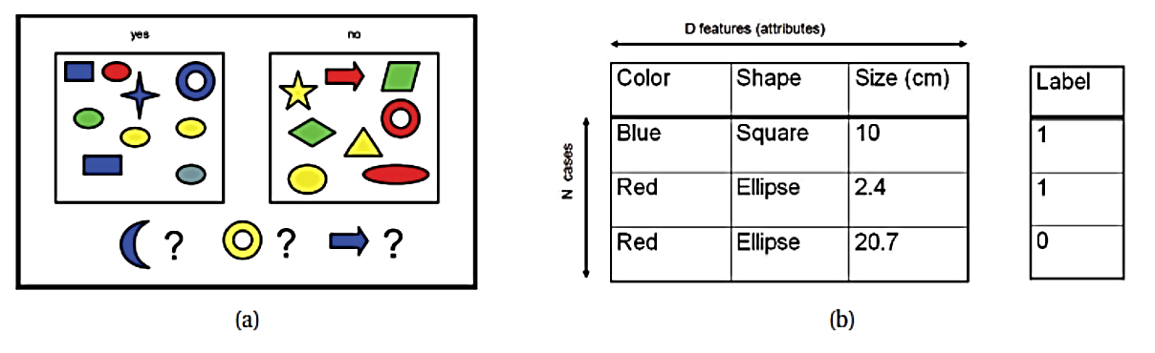
(a) Some labeled training examples of colored shapes, along with 3 unlabeled test cases. (b): Representing the training data as an N × D design matrix. Row i represents the feature vector xi. The last column is the label, yi ∈ {0, 1}.

Slide 15

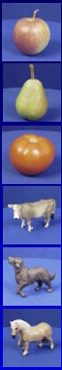
Generalization
Training set (labels known)
Test set (labels unknown)
How well does a learned model generalize from the data it was trained on to a new test set?

Slide 16
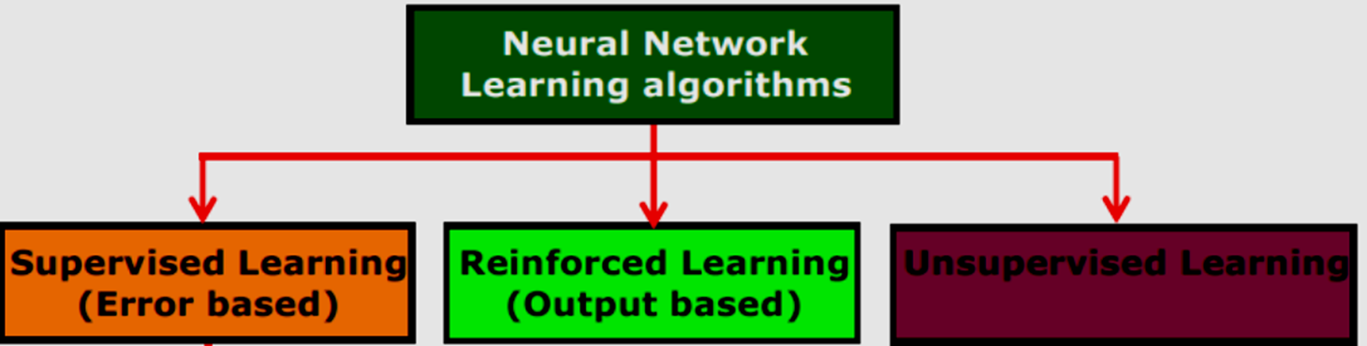
Machine Learning Areas
Supervised Learning: Data and corresponding labels are given
Unsupervised Learning: Only data is given, no labels provided
Semi-supervised Learning: Some (if not all) labels are present
Reinforcement Learning: An agent interacting with the world makes observations, takes actions, and is rewarded or punished; it should learn to choose actions in such a way as to obtain a lot of reward

Slide 17
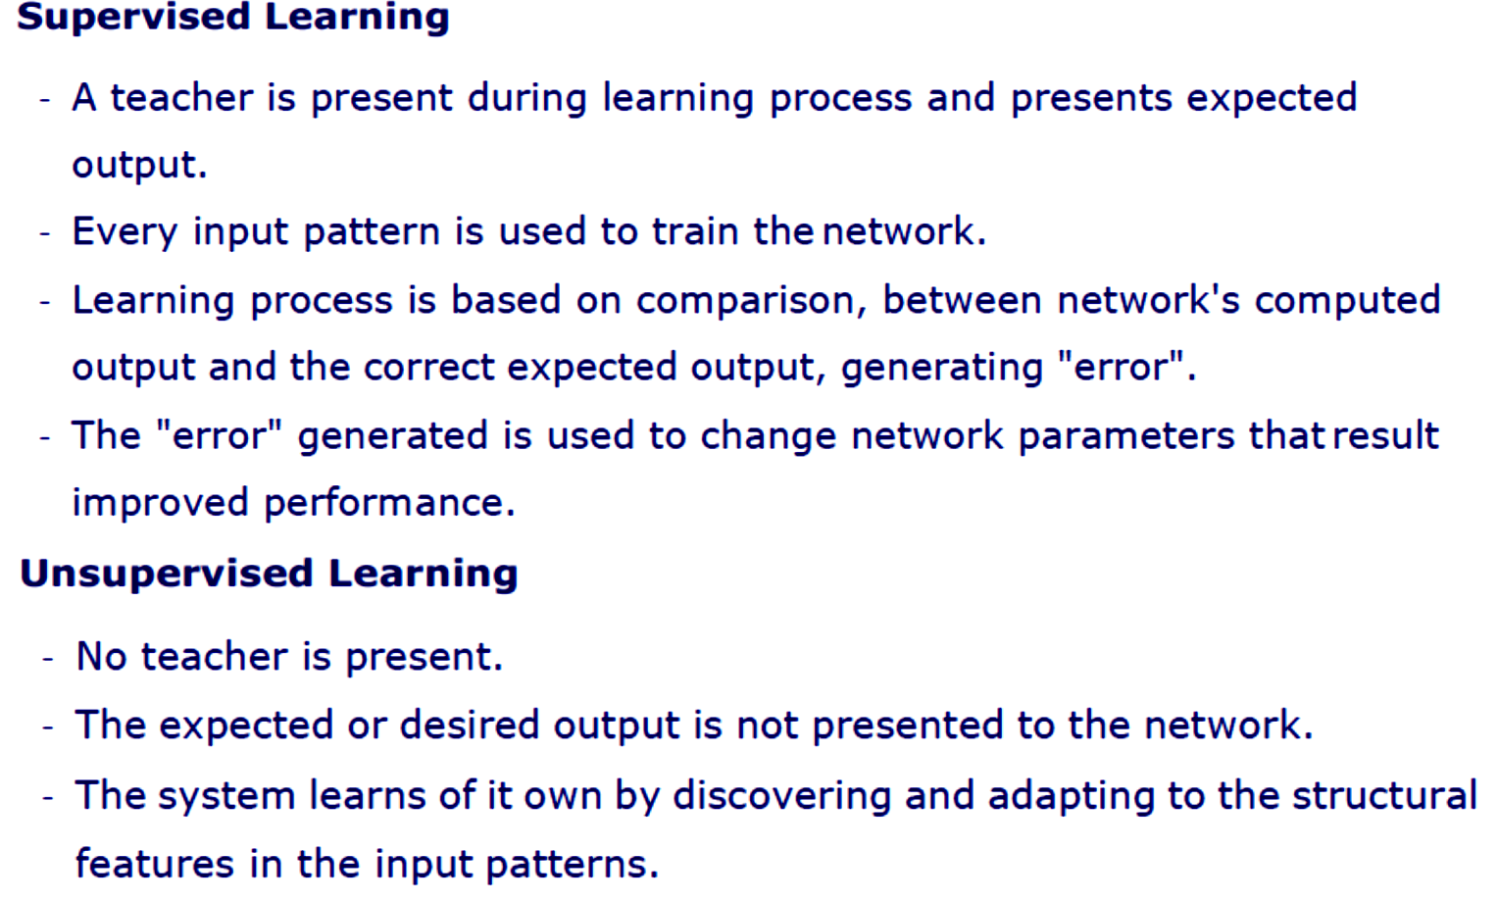
Representation and prior knowledge

Slide 18
In semi-supervised learning we are given a few labelled examples and must make what we can of a large collection of unlabelled examples. Even the labels themselves may not be the oracular truths that we hope for. Imagine that you are trying to build a system to guess a person’s age from a photo. You gather some labeled examples by snapping pictures of people and asking their age. That’s supervised learning. But in reality some of the people lied about their age.

Slide 19
Unsupervised Learning
In supervised learning, the aim is to learn a mapping from the input to an output whose correct values are provided by a supervisor.
In unsupervised learning, there is no such supervisor and we only have input data.
The aim is to find the regularities in the input.
Density Estimation - Clustering
There is a structure to the input space such that certain patterns occur more often than others, and we want to see what generally happens and what does not. In statistics, this is called density estimation. One method for density estimation is clustering where the aim is to find clusters or groupings of input.
In the case of a company with a data of past customers, the customer data contains the demographic information as well as the past transactions with the company, and the company may want to see the distribution of the profile of its customers, to see what type of customers frequently occur. In such a case, a clustering model allocates customers similar in their attributes to the same group, providing the company with natural groupings of its customers; this is called customer segmentation.

Slide 20
Reinforcement Learning
In some applications, the output of the system is a sequence of actions. In such a case, a single action is not important; what is important is the policy that is the sequence of correct actions to reach the goal. There is no such thing as the best action in any intermediate state; an action is good if it is part of a good policy. In such a case, the machine learning program should be able to assess the goodness of policies and learn from past good action sequences to be able to generate a policy. Such learning methods are called reinforcement learning algorithms.
A good example is game playing where a single move by itself is not that important; it is the sequence of right moves that is good. A move is good if it is part of a good game playing policy.
A robot navigating in an environment in search of a goal location is another application area of reinforcement learning. At any time, the robot can move in one of a number of directions. After a number of trial runs, it should learn the correct sequence of actions to reach to the goal state from an initial state, doing this as quickly as possible and without hitting any of the obstacles.

Slide 21
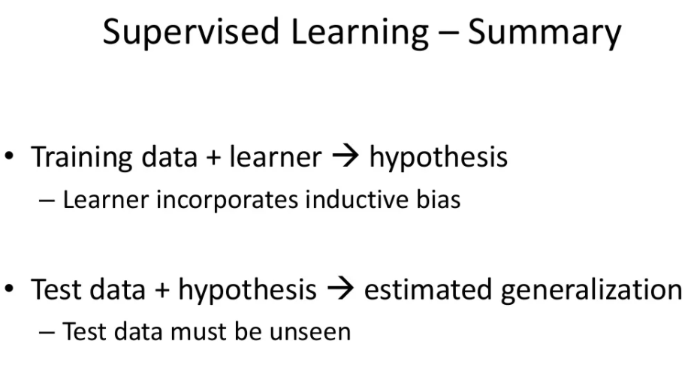

Slide 22
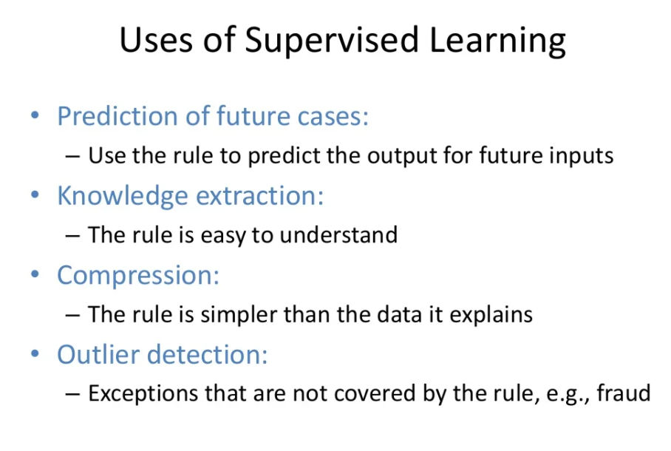

Slide 23
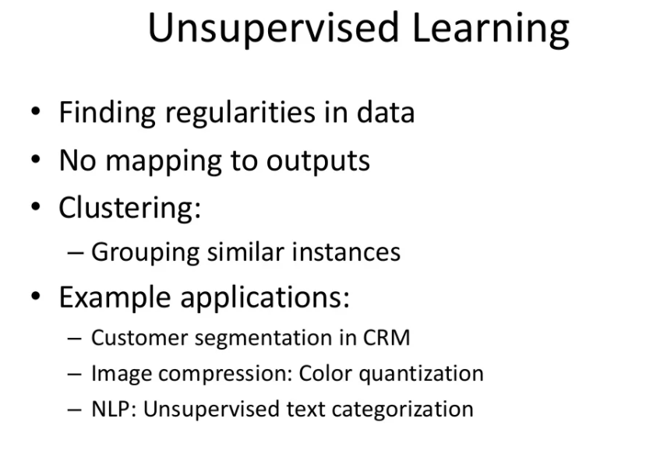

Slide 24
Noise
Noise is any unwanted anomaly in the data and due to noise, the class may be more difficult to learn and zero error may be infeasible with a simple hypothesis,
There may be imprecision in recording the input attributes, which may shift the data points in the input space.
There may be errors in labeling the data points, which may relabel positive instances as negative and vice versa. This is sometimes called teacher noise.
There may be additional attributes, which we have not taken into account, that affect the label of an instance. Such attributes may be hidden or latent in that they may be unobservable. The effect of these neglected attributes is thus modeled as a random component and is included in “noise.”

Slide 25
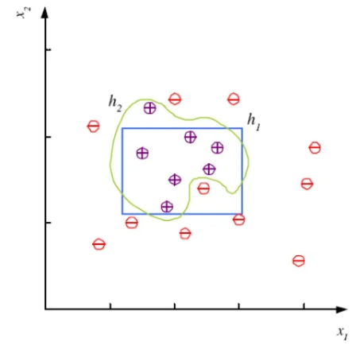

Slide 26
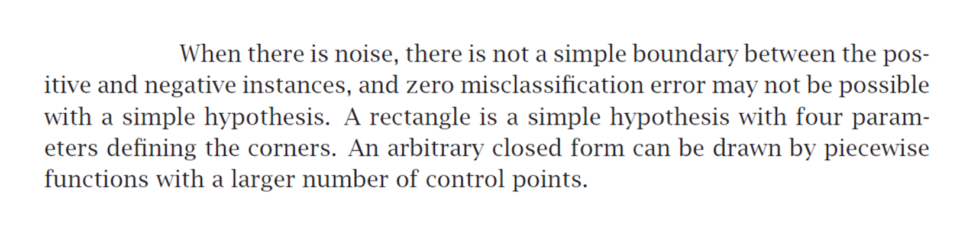

Slide 27
Bias-Variance Trade off
Bias
Bias is the difference between the average prediction of our model and the correct value which we are trying to predict.
Model with high bias pays very little attention to the training data and oversimplifies the model.
It always leads to high error on training and test data.
Variance
Variance is the variability of model prediction for a given data point or a value which tells us spread of our data.
Model with high variance pays a lot of attention to training data and does not generalize on the data which it hasn’t seen before.
As a result, such models perform very well on training data but has high error rates on test data.

Slide 28
In statistics and machine learning, the bias–variance trade-off is the property of a model that the variance of the parameter estimated across samples can be reduced by increasing the bias in the estimated parameters.
The bias–variance dilemma or bias–variance problem is the conflict in trying to simultaneously minimize these two sources of error that prevent supervised learning algorithms from generalizing beyond their training set:
The bias error is an error from erroneous assumptions in the learning algorithm. High bias can cause an algorithm to miss the relevant relations between features and target outputs (underfitting).
The variance is an error from sensitivity to small fluctuations in the training set. High variance may result from an algorithm modeling the random noise in the training data (overfitting).
The bias–variance decomposition is a way of analyzing a learning algorithm's expected generalization error with respect to a particular problem as a sum of three terms, the bias, variance, and a quantity called the irreducible error, resulting from noise in the problem itself.

Slide 29
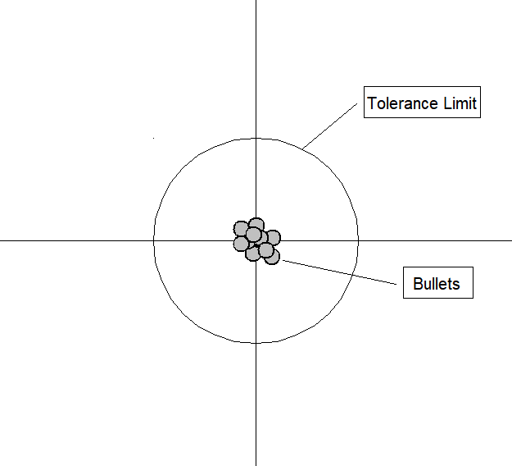
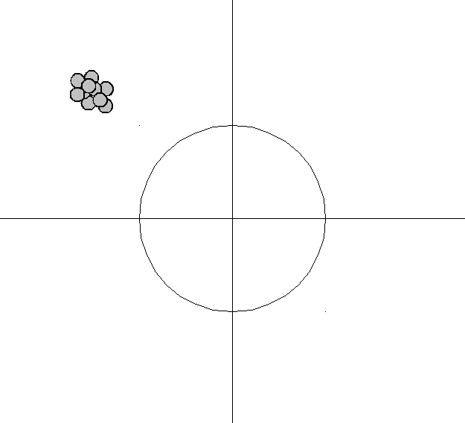
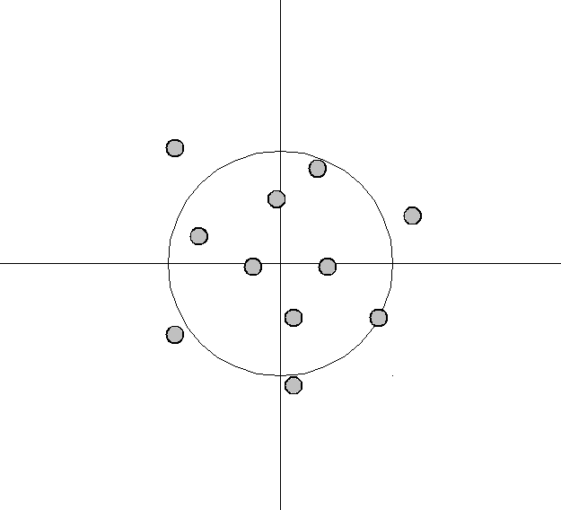
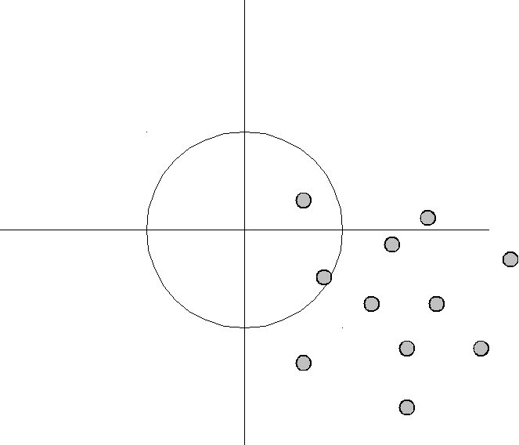
i
ii
i) Bias low, variance low ii) bias high, variance low
iii) bias low, variance high iv) bias high, variance high
iii
iv

Slide 30
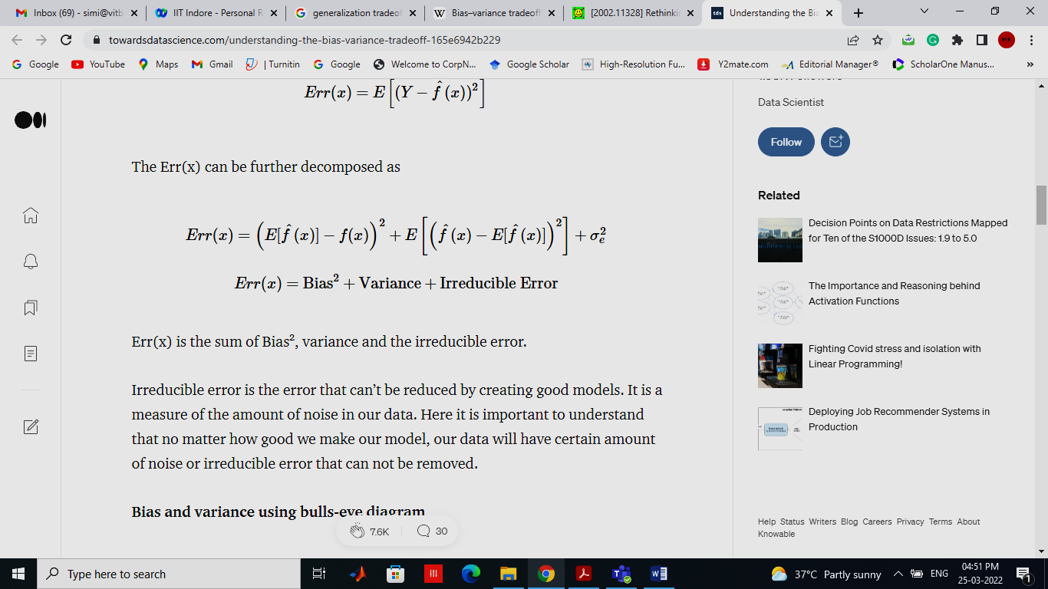

Slide 31
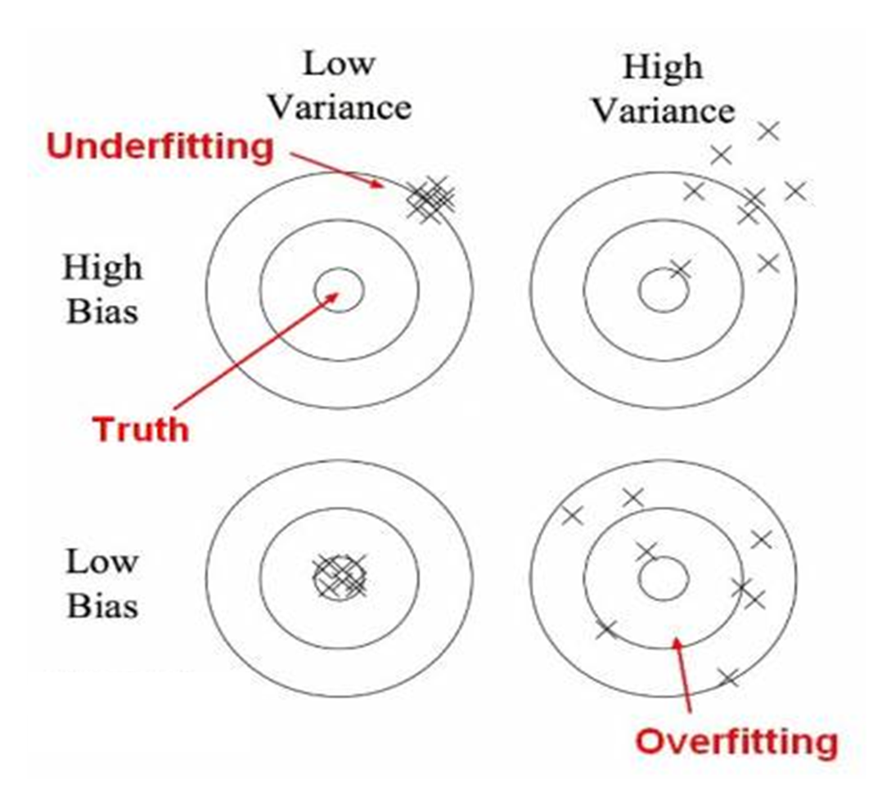
Bulls-eye diagram

Slide 32
In the above diagram, center of the target is a model that perfectly predicts correct values.
As we move away from the bulls-eye our predictions become get worse and worse.
We can repeat our process of model building to get separate hits on the target.
In supervised learning, underfitting happens when a model unable to capture the underlying pattern of the data. These models usually have high bias and low variance. It happens when we have very less amount of data to build an accurate model or when we try to build a linear model with a nonlinear data. Also, these kind of models are very simple to capture the complex patterns in data like Linear and logistic regression.
In supervised learning, overfitting happens when our model captures the noise along with the underlying pattern in data. It happens when we train our model a lot over noisy dataset. These models have low bias and high variance. These models are very complex like Decision trees which are prone to overfitting.

Slide 33
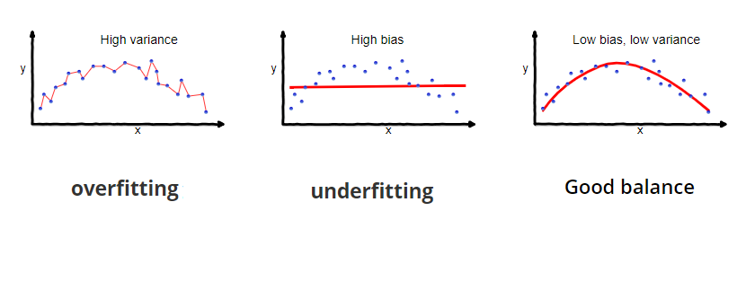

Slide 34
Probably Approximately Correct (PAC) learning
In computational learning theory, probably approximately correct (PAC) learning is a framework for mathematical analysis of machine learning.
It was proposed in 1984 by Leslie Valiant.
In this framework, the learner receives samples and must select a generalization function (called the hypothesis) from a certain class of possible functions.
The goal is that, with high probability (the "probably" part), the selected function will have low generalization error (the "approximately correct" part).
The learner must be able to learn the concept given any arbitrary approximation ratio, probability of success, or distribution of the samples.
The model was later extended to treat noise (misclassified samples).
An important innovation of the PAC framework is the introduction of computational complexity theory concepts to machine learning. In particular, the learner is expected to find efficient functions (time and space requirements bounded to a polynomial of the example size), and the learner itself must implement an efficient procedure (requiring an example count bounded to a polynomial of the concept size, modified by the approximation and likelihood bounds).

Slide 37
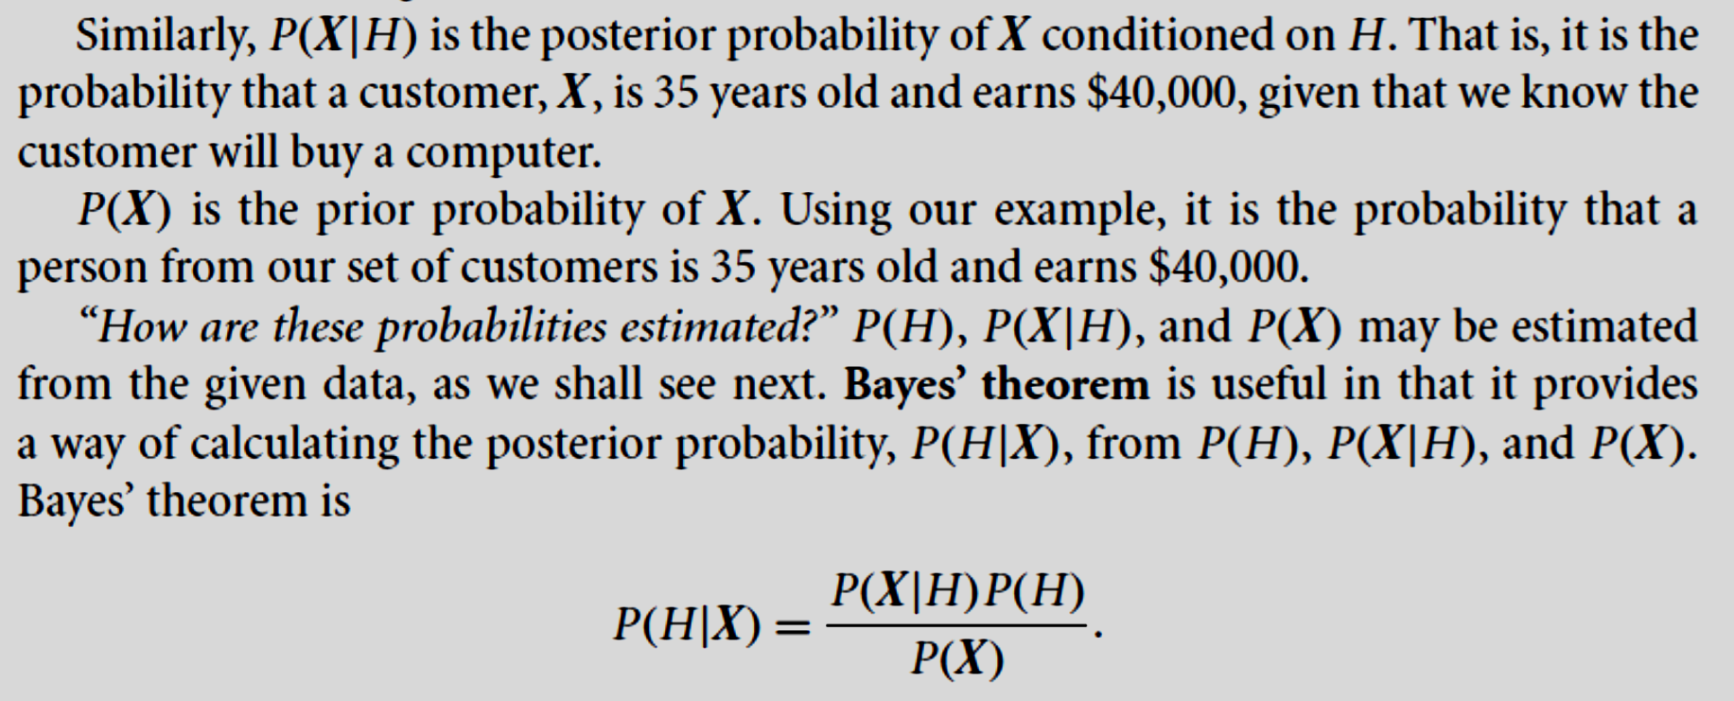

Slide 38
In a population with 200 people, 80 persons have throat pain and 60 persons have COVID infection. 40 COVID patients have throat pain. What is the probability that a person with throat pain have COVID.?
P(H/X)= P(X/H) P(H) / P(X)
= (40/60)* (60/200) / (80/200)
=0.66*0.3/0.4
= 0.495

Slide 39
Minimum Description Length (MDL) Principle
Minimum description length (MDL) is a model selection principle where the shortest description of the data is the best model. MDL methods learn through a data compression perspective and are sometimes described as mathematical applications of Occam's razor. The MDL principle can be extended to other forms of inductive inference and learning, for example to estimation and sequential prediction, without explicitly identifying a single model of the data.
MDL has its origins mostly in information theory and has been further developed within the general fields of statistics, theoretical computer science and machine learning, and more narrowly computational learning theory.

Slide 40
References
Ethem Alpaydin, Introduction to Machine Learning , MIT Press, Prentice Hall of India, Third Edition 2014.
J-S R Jang and C-T Sun, Neuro-Fuzzy and Soft Computing, Prentice Hall, 1997
S. Rajasekaran and G.A. Vijayalaksmi Pai ,Neural Network, Fuzzy Logic, and Genetic Algorithms - Synthesis and Applications, (2005), Prentice Hall.

